Slide 1
AHB to apb Bridge verification
Presented by
Aravind k

Slide 2
abstract
The Advanced Microcontroller Bus Architecture (AMBA) is an open System-on-Chip bus protocol for high performance buses to communicate with low-power devices.
Advanced High-performance Bus (AHB) a system bus is used to connect a processor, a DSP, and high-performance memory controllers where as the AMBA Advanced Peripheral Bus (APB) is used to connect Low performance Peripherals.
It also contains a Bridge, which connects the AHB and APB buses. Bridges are standard bus-to-bus interfaces that allow IPs connected to different buses to communicate with each other in a standardized way.

Slide 3
AHB (AMBA High-performance Bus)
AHB is a bus interface suitable for high-performance synthesizable designs.
Supports Multiple Master Multiple Slaves(MMMS).
Transfer boundary limit=1Kb( This project supports 32bits(4bytes) ).
AMBA AHB implements the features:
Burst transfers.
Pipelined operation.
Split transactions (separate phases for address and data)
Insertion of wait states (max 16 wait-states allowed at a stretch)
Wide data bus configurations, 64, 128, 256, 512, and 1024 bits.

Slide 4
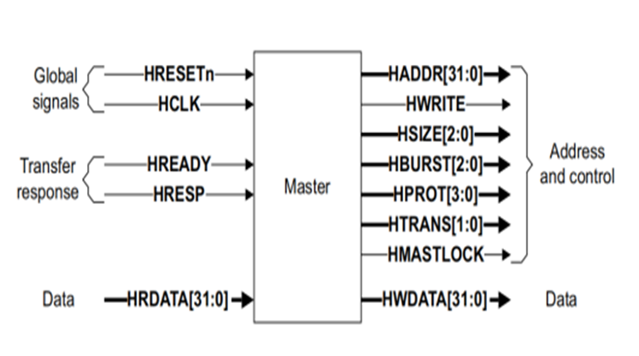
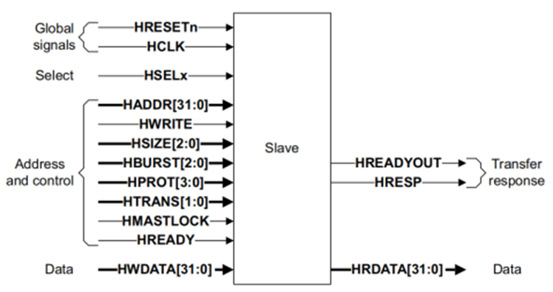
AHB Overview
Types of operation
Read
Write
Types of transfer
Idle
Busy
Non-sequential
Sequential
Transfer size allowed
1byte
2bytes
4 bytes
Types of Burst
Single
Undefined
Increment(4,8,16)
Wrapping(4,8,16)

Slide 5
APB (Advanced Peripheral Bus)
low-cost interface that is optimized for minimal power consumption and reduced interface complexity.
The APB protocol does not support pipelined operation.
Latched address and control.
Supports one master multiple slave
Every transfer takes at least two cycles.
Three states: IDLE,SETUP & ENABLE.

Slide 6
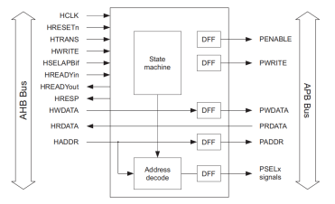
Ahb to APB bridge
Interface between the AHB and APB.
Read and write transfers on the AHB are converted into equivalent transfers on the APB.
As the APB is not pipelined, then wait states are added during transfers to and from the APB when the AHB is required to wait for the APB.
Ensures that there is no data loss between AHB to APB or APB to AHB data transfers.
It buffers address, controls and data from the AHB, drives the APB peripherals and return data along with response signal to the AHB.
Bridge is the only master on the bus, PWDATA is driven continuously. PRDATA is a multiplexed connection of all peripheral PRDATA outputs on the bus, and is only driven when the slaves are selected by the bridge during APB read transfers.

Slide 7
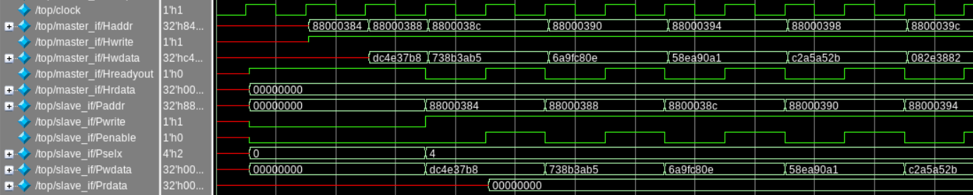
Write Transfer

Slide 8
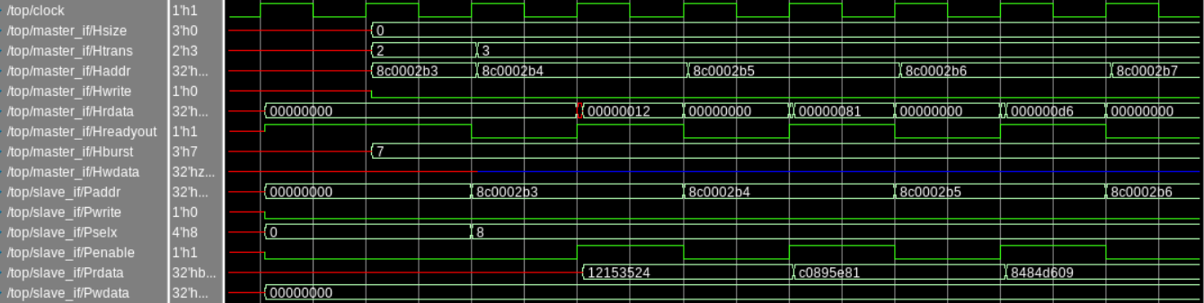
Read transfer

Slide 9
Increment and Wrapping
INCREMENT | WRAPPING
Example: Hburst=INC4 4. HSIZE = '010' (32 bit word Accesses) start address=0x1018 0x1018 0x101C 0x1020 0x1024 burst (address) will increment based on the size of the transfer. Size of transfer = 2^(HSIZE) 1 for HSIZE = 0, Beat Length = 4 for INC4, 2 for HSIZE = 1, 8 for INC8, 4 for HSIZE = 2, 16 for INC16. | Example: Hburst=WRAP 4. HSIZE = '010' (32 bit word Accesses) start address=0x1018 0x1018 0x101C 0x1010 (instead of 0x1020) 0x1014 (instead of 0x1024) Because the burst will wrap around the burst boundary at 0x001F, also called block size boundary. Wrap boundary= Size of transfer * Beat length. Size of transfer = 2^(HSIZE) 1 for HSIZE = 0, Beat Length = 4 for WRAP4, 2 for HSIZE = 1, 8 for WRAP8, 4 for HSIZE = 2, 16 for WRAP16. 8 for HSIZE = 3

Slide 10
Thank you
“ANYONE CAN BUILD A FAST CPU.THE TRICK IS TO BUILD A FAST SYSTEM”

